Slide 1
QUEENS COLLEGE OF ARTS AND SCIENCE FOR WOMEN, Punalkulam, NEAR THANJAVUR, Pudukkottai (Dt)
DEPARTMENT : MATHEMATICS
SUBJECT : VECTOR CALCULUS & FOURIER SERIES
UNIT : IV
TOPIC : FOURIER SERIES
SUBJECT CODE : 16SCCMM7
PREPARED STAFF : Dr. S. SRIDEVI
DESGINATION : ASSISTNAT PROFESSOR

Slide 2
Fourier Series Section - A

Slide 3
CONT

Slide 4
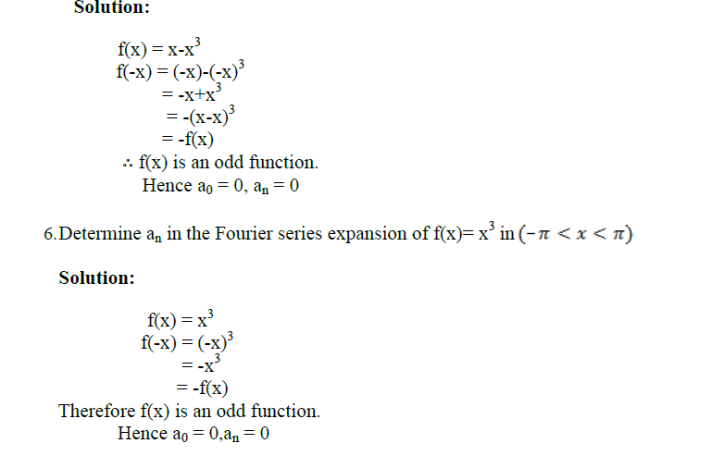
CONT.

Slide 5
CONT.

Slide 6
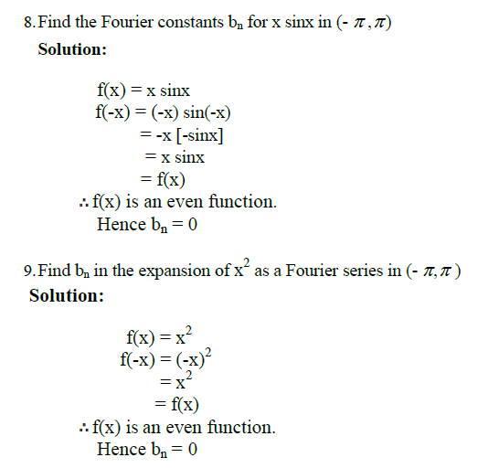
CONT.

Slide 7
CONT

Slide 8
Section -B

Slide 9
Cont.

Slide 10
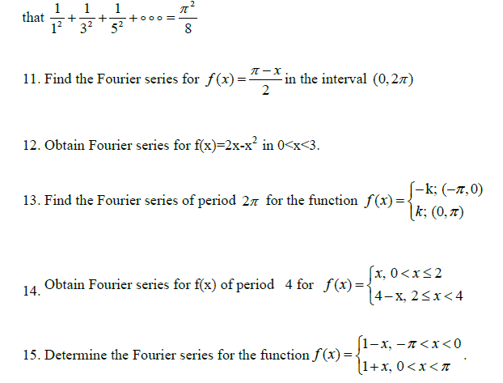
Cont.

Slide 11
Section-c

Slide 12
Cont.

