Slide 1
Dr. Faustus
-Christopher Marlowe

Slide 2
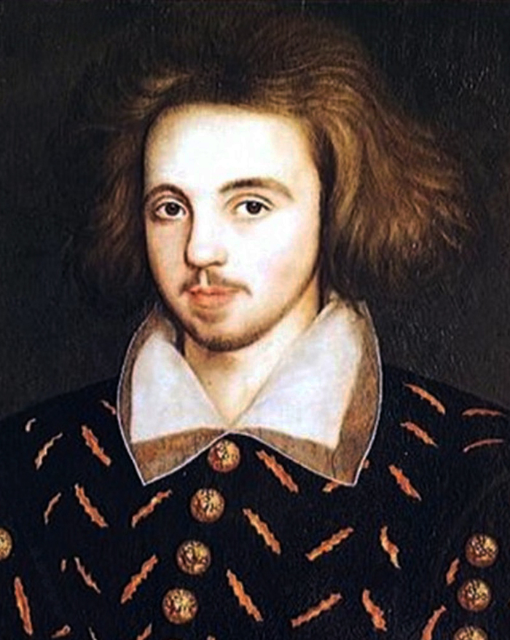
CHRISTOPHER MARLOWE

Slide 3
Christopher Marlowe, also known as Kit Marlowe (26 February 1564 – 30 May 1593), was an English playwright, poet and translator of the Elizabethan era.
Marlowe was the foremost Elizabethan tragedian of his day. He greatly influenced William Shakespeare, who was born in the same year as Marlowe and who rose to become the pre-eminent Elizabethan playwright after Marlowe's mysterious early death.
Marlowe's plays are known for the use of blank verse and their overreaching protagonists

Slide 4
Faustus
A brilliant man, who seems to have reached the limits of natural knowledge. Faustus is a scholar of the early sixteenth century in the German city of Wittenburg.
He is arrogant, fiery, and possesses a thirst for knowledge. As an intellectual, Faustus is familiar with things (like demon summoning and astrology) not normally considered academic subjects by today's universities.
Faustus decides to sell his soul to the devil in exchange for earthly power and knowledge and an additional 24 years of life. He proceeds to waste this time on self-indulgence and low tricks.

Slide 5
Mephodtophilis
In Marlowe's play, Mephostophilis has layers to his personality. He admits that separation from God is anguish, and is capable of fear and pain.
But he is gleefully evil, participating at every level in Faustus' destruction. Not only does Mephostophilis get Faustus to sell his soul; he also encourages Faustus to waste his twenty-four years of power.

Slide 6
Wagner
Servant to Faustus. He steals Faustus' books and learns how to summon demons. At the end of the play, he seems concerned about his master's fate.

Slide 7
Good Angel and Evil Angel
Personifications of Faustus' inner turmoil, who give differing advice to him at key points. Their characters also reflect Christian belief that humans are assigned guardian angels, and that devils can influence human thoughts.

Slide 8
Lucifer
Satan. "Lucifer" original meant Venus, referring to the planet's brilliance. In Christian lore, Lucifer is sometimes thought to be another name of Satan.
Some traditions say that Lucifer was Satan's name before the fall, while the Fathers of the Catholic Church held that Lucifer was not Satan's proper name but a word showing the brilliance and beauty of his station before the fall.
He appears at a few choice moments in Doctor Faustus, and Marlowe uses "Lucifer" as Satan's proper name.

Slide 9
The Seven Deadly Sins
Personifications of the Seven Deadly Sins, not acts but impulses or motivations that lead men to sinful actions. They array themselves in a pageant before Faustus, although scholars think now that this section was not written by Marlowe.

Slide 10
Clown / Robin
Robin learns demon summoning by stealing one of Faustus' books. He is the chief character in a number of scenes that provide comic relief from the main story.

Slide 11
SUMMARY

Slide 12
Doctor Faustus, scholar and lover of beauty, chafes at the bit of human limitation. He seeks to achieve godhood himself, and so he leaves behind the Christian conceptions of human limitation.
Though he fancies himself to be a seeker of Greek greatness, we see quickly that he is not up to the task.

Slide 13
Pride, and Sin
Pride is one of the Seven Deadly Sins, arguable the one that leads to all the others. Within the Christian framework, pride is a lethal motivation because it makes the sinner forget his fallen state.
For Christians, men are fallen since birth, because they carry with them the taint of original sin. A men made haughty with pride forgets that he shares Eve's sin, and must therefore be saved by the gift of grace.
Only God, through Christ, can dispense this grace, and the man who forgets that fact deprives himself of the path to salvation.

Slide 14
Faustus' first great sin is pride. He does not stop there. Reflecting the Christian view, pride gives rise to all of the other sins, and ends ironically with the proud man's abasement.
Faustus goes quickly from pride to all of the other sins, becoming increasingly petty and low.

Slide 15
Damnation
Damnation is eternal. Eternal hell is another concept that Westerners take for granted as part of religion, but again this belief's uniqueness needs to be appreciated.
Faustus dies without repenting and accepting God, he will be damned forever. As we learn from Mephostophilis, hell is not merely a place, but separation from God's love.

Slide 16
Salvation, Mercy, and Redemption
Hell is eternal, but so is heaven. For a Christian, all that is necessary to be saved from eternal damnation is acceptance of Jesus Christ's grace. Even after signing away his soul to the devil, Faustus has the option of repentance that will save him from hell.
But once he has committed himself to his own damnation, Faustus seems unable to change his course. While Christianity seems to accept even a deathbed repentance as acceptable for the attainment of salvation, Marlowe plays with that idea, possibly rejecting it for his own thematic purposes. (See analysis of 5.2-end of the play).
Valuing Knowledge over Wisdom

Slide 17
Doctor Faustus (Marlowe) Summary
Buy Study Guide
Doctor Faustus, a talented German scholar at Wittenburg, rails against the limits of human knowledge. He has learned everything he can learn, or so he thinks, from the conventional academic disciplines. All of these things have left him unsatisfied, so now he turns to magic.

Slide 18
A Good Angle and an Evil Angel arrive, representing Faustus' choice between Christian conscience and the path to damnation. The former advises him to leave off this pursuit of magic, and the latter tempts him.
From two fellow scholars, Valdes and Cornelius, Faustus learns the fundamentals of the black arts. He thrills at the power he will have, and the great feats he'll perform

Slide 19
He summons the devil Mephostophilis. They flesh out the terms of their agreement, with Mephostophilis representing Lucifer.
Faustus will sell his soul, in exchange for twenty-four years of power, with Mephostophilis as servant to his every whim.

Slide 20
In a comic relief scene, we learn that Faustus' servant Wagner has gleaned some magic learning. He uses it to convince Robin the Clown to be his servant.
Before the time comes to sign the contract, Faustus has misgivings, but he puts them aside.
Mephostophilis returns, and Faustus signs away his soul, writing with his own blood. The words "Homo fuge" ("Fly, man) appear on his arm, and Faustus is seized by fear.
Mephostophilis distracts him with a dance of devils. Faustus requests a wife, a demand Mephostophilis denies, but he does give Faustus books full of knowledge.

Slide 21
Some time has passed. Faustus curses Mephostophilis for depriving him of heaven, although he has seen many wonders. He manages to torment Mephostophilis, he can't stomach mention of God, and the devil flees.
The Good Angel and Evil Angel arrive again. The Good Angel tells him to repent, and the Evil Angel tells him to stick to his wicked ways. Lucifer, Belzebub, and Mephostophilis return, to intimidate Faustus. He is cowed by them, and agrees to speak and think no more of God.
They delight him with a pageant of the Seven Deadly Sins, and then Lucifer promises to show Faustus hell. Meanwhile, Robin the Clown has gotten one of Faustus' magic books.

Slide 22
Faustus' twenty-four years are running out. Wagner tells the audience that he thinks Faustus prepares for death. He has made his will, leaving all to Wagner. But even as death approaches, Faustus spends his days feasting and drinking with the other students.
For the delight of his fellow scholars, Faustus summons a spirit to take the shape of Helen of Troy. Later, an Old Man enters, warning Faustus to repent.
Faustus opts for pleasure instead, and asks Mephostophilis to bring Helen of Troy to him, to be his love and comfort during these last days. Mephostophilis readily agrees.

Slide 23
As the hour approaches, Mephostophilis taunts Faustus. Faustus blames Mephostophilis for his damnation, and the devil proudly takes credit for it.
The Good and Evil Angel arrive, and the Good Angel abandons Faustus. The gates of Hell open. The Evil Angel taunts Faustus, naming the horrible tortures seen there.

Slide 24
The Clock strikes eleven. Faustus gives a final, frenzied monologue, regretting his choices. At midnight the devils enter. As Faustus begs God and the devil for mercy, the devils drag him away.
Later, the Scholar friends find Faustus' body, torn to pieces.
Epilogue. The Chorus emphasizes that Faustus is gone, his once-great potential wasted. The Chorus warns the audience to remember his fall, and the lessons it offers.

Slide 25
THANK YOU

