Slide 1
National Income
B.COM- II SEMESTER
MANAGERIAL ECONOMICS

Slide 2
What is National Income?
National income measures the total value of goods and services produced within the economy over a period of time.

Slide 3
Why is national income important?
Measuring the level and rate of growth of national income is important to economists when they are considering:
  Economic growth and where a country is in the business cycle
  Changes to average living standards of the population
  Looking at the distribution of national income (i.e. measuring income and wealth inequalities)

Slide 4
NATIONAL INCOME CONCEPTS
Gross domestic product (GDP) is defined as "an aggregate measure of production equal to the sum of the gross values added of all resident institutional units engaged in production
Gross national product (GNP) is the market value of all the productsand services produced in one year by labor and property supplied by the citizens of a country.

Slide 5
Personal Income (PI)
Personal Income i s the total money income received by individuals and households of a country from all possible sources before direct taxes.
Per Capita Income (PCI)
Per Capita Income of a country is derived by dividing the national income of the country by the total population of a country.

Slide 6
National Income:
Concept and Measurement
Production of goods and service generates income and income give rise to demand for goods and service, demand give rise to expenditure, and expenditure give further rise to production of goods and service. there is a circular flow of production, income and expenditure.
  On the basis of these flows, national income can be analysed at
as a flow of goods and services
as a flow of incomes
as a flow of expenditure on goods and services.

Slide 7
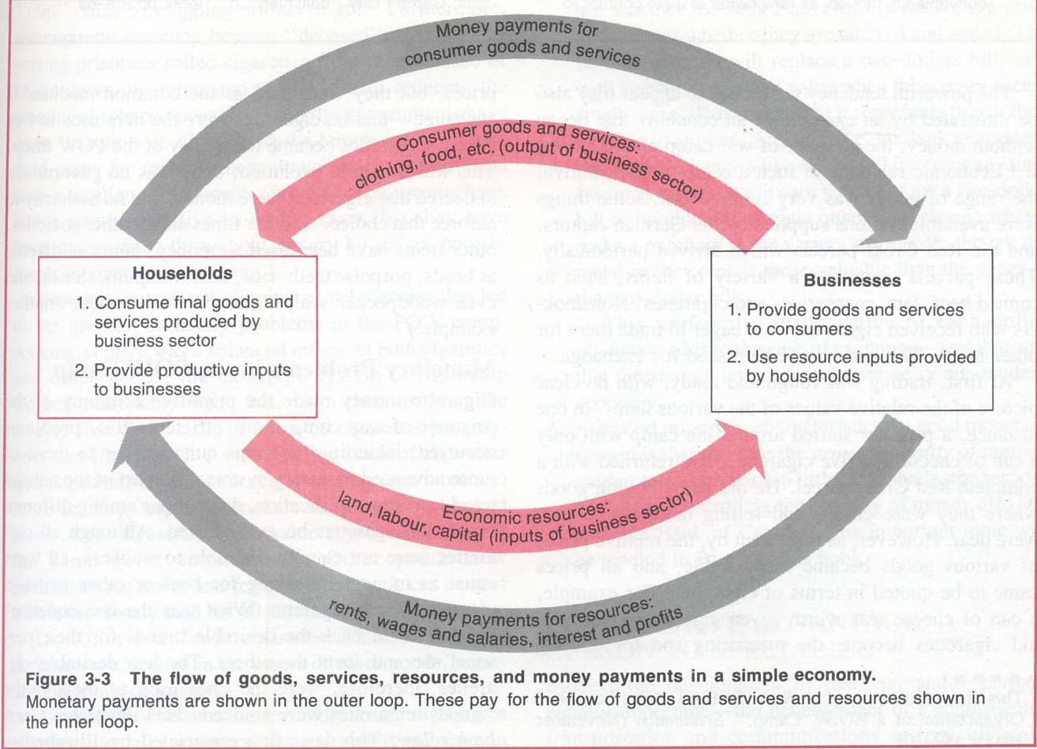
Figure: Measuring National Product and National Income

Slide 8
A. Product Method
(a) Final product approach
The final product approach involves estimation of the market value of final goods and services produced in the economy in a given period.

Slide 9
Steps in Final Product Approach:
The market value of all final goods and service produced within the country gives the estimate of Gross Domestic Product at Market Price (GDP at MP)
The addition of net factor income from abroad in GDP at MP gives Gross National Product at Market Price (GNP at MP).
The deduction of depreciation from Gross National Product at market price (GNP at MP) MP provides Net National Product at market Price (NNP at MP).
The deduction of net indirect taxes from NNP at MP give Net National Product at Factor Cost (NNP at FC)

Slide 10

Problem of Double Counting
The calculation of national income through final product approach considers the market value of final goods and services.
The value of intermediate goods is not included. If the value of intermediate goods are considered, it will involve the problem of double counting.
Double counting means, consideration of certain item more than once which leads to over estimation of national income.

Slide 11
B. Income Method
It is the sum of all income derived from providing the factors of production.
It includes wages and salaries, rent, interest and profits within a country in a given year.

Slide 12
Steps in Income Method:
Obtain Net Domestic Product at Factor cost (NDP at FC) by summing up factors payment paid in form of wages & salary, rent, interest and profit by all production units of all sectors in the country.
Add Net factor income from abroad in Net Domestic Product at Factor Cost to obtain Net National Product at Factor Cost (NNP at FC) or national income.

Slide 13
C. Expenditure Method
Expenditure method measures national income as aggregate of all the final expenditure on gross domestic product in an economy during a year.
This is the sum of expenditure made for final consumer goods and
investment demand, and for net export.
Therefore, the sum of total income (Y) equals to the sum of final expenditure incurred on consumption goods (C) and the sum of investment goods (I). Symbolically, Y = C + I.

Slide 14
Steps in Expenditure Method:
GDP at MP = Gross National Expenditure at Market Price (GNE at MP) which the sum of Final private consumption expenditure (C), Government final consumption expenditure (G), Gross domestic private investment (I) which includes gross fixed capital formation plus changes in stocks, and Net export or export minus import (X- M)
An addition of net factor income from abroad (NFIA) to GDP at MP provides Gross National Product at market price (GNP at MP).

Slide 15

Factors to be taken care:
Expenditure on second hand goods should be excluded It is because such expenditure on the goods is not considered to be expenditure on currently produced goods.
Expenditure on the purchase of new or old shares and bonds should be excluded because they are not payments for goods and services.
Government expenditure in the form of transfer payments should be excluded because these payments do not make any contribution to the flow of goods and services.
Expenditure on intermediate goods and services should be excluded, otherwise this will lead to the problem of double counting.

Slide 16
Is the measurement of NI is an easy
task?
There are challenges of measuring NI, some of them are as follows:
  Simon Kuznet’s difficulties (Definition of the term Nation, Method to be used, Stage of economic activity, Types of goods and services)
  Problem of double counting
  Transfer payments
  Income generated by foreign firms
  Calculation of depreciation.

Slide 17
What are the uses of national income
statistics?
Formulation of economic policies
Studying economic structure
Inter- sectoral comparisons
Indicator of economic welfare
Making international comparisons

