Slide 1
A.LAKSHIKA, ASSISTANT PROFFESSSOR, DEPARTMENT OF FASHION TECHNOLOGY AND COSTUME DESIGNING, BON SECOURS ARTS AND SCIENCE COLLEGE FOR WOMEN, MANNARGUDI
SEWING TECHNIQUES
UNIT-5 TRIMMING

Slide 2
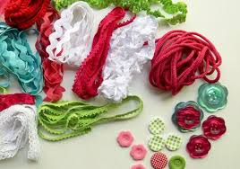
TRIMMING
Trim or trimming in clothing and home decorating is applied ornament, such as gimp, passementerie, ribbon, ruffles, or, as a verb, to apply such ornament. Before the industrial revolution, all trim was made and applied by hand, thus making heavily trimmed furnishings and garments expensive and high-status.

Slide 3
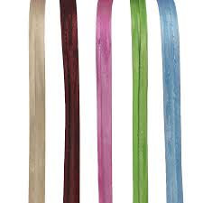
BIAS TRIMMING
Bias tape or bias binding is a narrow strip of fabric, cut on the bias. The strip's fibers, being at 45 degrees to the length of the strip, makes it stretchier as well as more fluid and more drapeable compared to a strip that is cut on the grain. Many strips can be pieced together into a long "tape." The tape's width varies from about 1/2" to about 3" depending on applications. Bias tape is used in making piping, binding seams, finishing raw edges, etc. It is often used on the edges of quilts, placemats, and bibs, around armhole and neckline edges instead of a facing, and as a simple strap or tie for casual bags or clothing.

Slide 4
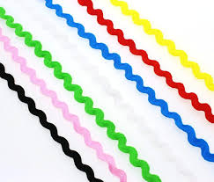
RIC RAC
Rickrack is a flat piece of braided trim, shaped like a zigzag. It is used as a decorative element in clothes or curtains.

Slide 5
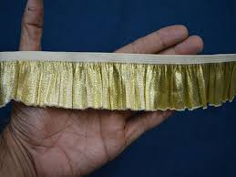
RUFFLE
In sewing and dressmaking, a ruffle, frill, or furbelow is a strip of fabric, lace or ribbon tightly gathered or pleated on one edge and applied to a garment, bedding, or other textile as a form of trimming.

Slide 6
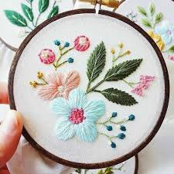
EMBROIDERY
Embroidery is the craft of decorating fabric or other materials using a needle to apply thread or yarn. Embroidery may also incorporate other materials such as pearls, beads, quills, and sequins.

Slide 7
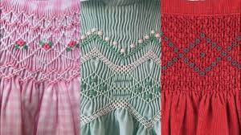
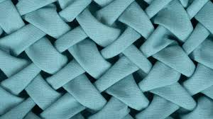
SMOCKING
Smocking is an embroidery technique used to gather fabric so that it can stretch. Before elastic, smocking was commonly used in cuffs, bodices, and necklines in garments where buttons were undesirable.

Slide 8
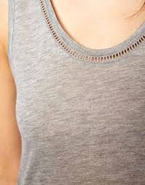
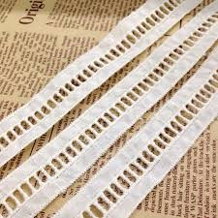
FAGGOTING
embroidery in which threads are fastened together in bundles.

Slide 9
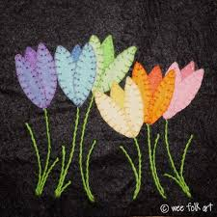
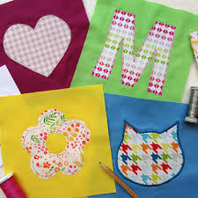
APPLIQUE
Appliqué is ornamental needlework in which pieces or patch of fabric in different shapes and patterns are sewn or stuck onto a larger piece to form a picture or pattern. It is commonly used as decoration, especially on garments.

Slide 10
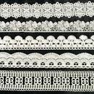
LACE
a delicate decorative fabric made from cotton, silk, etc., woven in an open web of different symmetrical patterns and figures

Slide 11
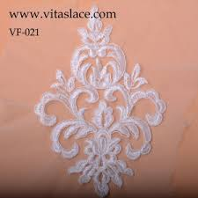
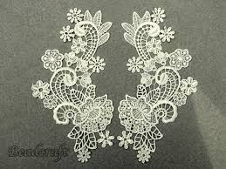
LACE MOTIFS

Slide 12
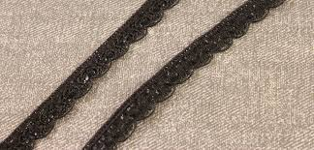
SCALLOPED EDGING

Slide 13
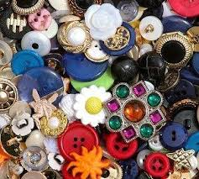
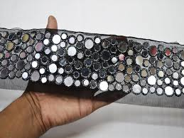
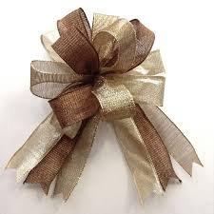
DECORATIVE FASTENING
BOW
BELT
BUTTONS

Slide 14
THANK YOU

