Slide 1
 | Sengamala Thayaar Educational Trust Women’s College (Affiliated to Bharathidasan University) (Accredited with ‘A’ Grade {3.45/4.00} By NAAC) (An ISO 9001: 2015 Certified Institution) Sundarakkottai, Mannargudi-614 016. Thiruvarur (Dt.), Tamil Nadu, India.
MEC III-BASIC BIOTECHNOLOGY-16SMBEBC3
Dr. R. ANURADHA
ASSISTANT PROFESSOR & HEAD
PG & RESEARCH DEPARTMENT OF BIOCHEMISTRY

Slide 3
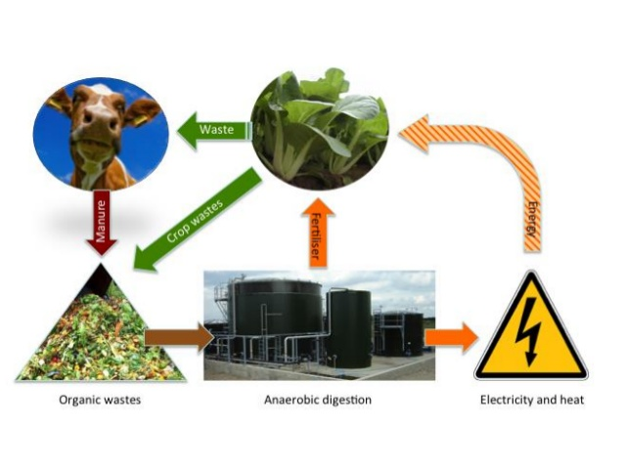
INTRODUCTION
Biogas or fuel gas consists of methane and carbondioxide in the ratio 2:;1.It has 65% methane,30% carbondioxide,1% of hydrogen sulphide and 4% of remaining compounds like oxygen, hydrogen, nitrogen and carbon monoxide.It is produced by fermentation effected by anaerobic bacteria called METHANOGENS.The microbial conversion of biomass into methane was first discovered by Volta in 1776.Volta demonstrated the presence of methane in marsh gas.

Slide 4
CHARACTERISTIC FEATURES
Biogas is a colourless mixture of gases.
It contains methane,carbondioxide,hydrogen sulphide,nitrogen,oxygen,hydrogen and carbon monoxide.
It is a odourless gas.
It burns with a blue flame.
It does not release smoke while burning.
It does not release kitchen refuse while burning.

Slide 5
PRODUCTION OF BIOGAS
1.SELECTION OF FEEDSTOCK
2.SELECTION OFMETHANOGENS.
3.CONSTRUCTION OF BIOGAS PLANT.
4.METHANE FORMATION.

Slide 6
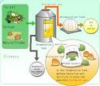
SELECTION OF FEEDSTOCK
The organic waste that is used in fermentation is called feedstock.
Generally cattle dung,pig dung,excreta of goats are used as feed stock for the production of biogas.
Sugarcane bagasse,corn stubble,straw ,urine are used as feedstock.

Slide 7
SELECTION OF METHANOGENS
Microorganisms which produce methane under anaerobic conditions are called methanogens. The important methanogens are :
A.Methanobacterium
B.Methanococcus vannielii.
C.Methanomicrobium sps
D.Methanogenium.
Salient features;
Methanogens are anaerobes.
They are mesophilic ,grow 21-45’C.
They have coenzyme M that reduces methyl group into methane.

Slide 8
CONSTRUCTION OF BIOGAS PLANTS
Two types of biogas plants are constructed to produce biogas.
They are
Floating gas holder type
Fixed dome type.

Slide 9
FLOATING GAS HOLDER TYPE
A typical floating gas holder type biogas unit mainly consists of two parts.
One is a fermenter to effect gas production and the other is a gas holder to collect the gas produced in the fermenter.
The fermenter has an inlet to add slurry and semi solid wastes into the fermenter and an outlet to remove the digested slurry.The complete biogas production is effected on it.
The gas holder is a large sized drum kept above the fermenter to collect the gas produced in the fermenter.The gas holder has an outlet to supply the gas for distribution.
The gas holder collects the gas released from the fermenter and moves upwards .When the gas is used simulatanously the gas holder moves downwards.

Slide 10
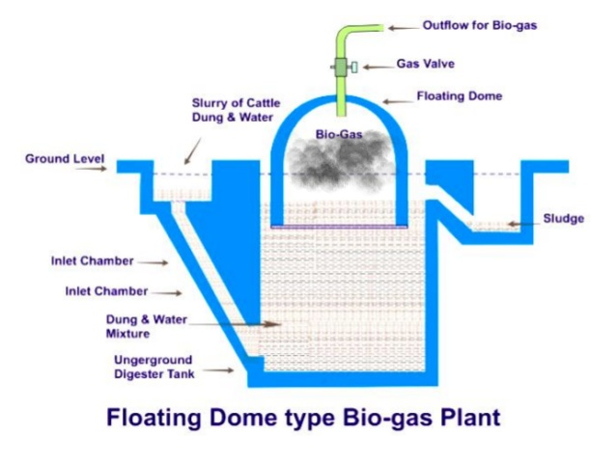

Slide 11
FIXED DOME TYPE
The gas holder and the fermenter are designed as a combined unit.It is kept in the soil.The gas holder is a dome like structure firmly fixed with the fermenter.
Gas id produced in the fermenter. This gas rises up ,and gets collected in the gas holder.When the pressure of gas inside the gas holder reaches the maximum,the gas pushes the digested slurry downwards.So digested slurry comes out through the outlet.Then fresh slurry is added into the fermenter through the inlet.
On the basis of the shape of the biogas units, the biogas plants are SPHERICAL DIGESTER,GLOBAL DIGESTER.

Slide 13
METHANE FERMENTATION
Cow dung is diluted to 50%by adding water to it.As a result ,the solid and liquid ration becomes 1:;1.The concentration favors the growth of acetogenic and methanogeneic bacteria.
The diluted feedstock is then pumped into the fermenter.
A small amount of digested slurry is taken from a working biogas plant and used as a inoclum.The inoculum is pumped into the fermenter.If slurry not available ,culture of acetogeneic and methanogeneic bacteria are inoculated into the fermenter.
METHANOBACTERIUM KADOMENESIS strain 23 one of the important methane producer:it produces equal amount of methane within 8 days .

Slide 14
STAGES OF METHANOGENESIS
Cellulose and other poly saccharides are digested by cellulolytic bacteria.
Simple sugars are formed EG: Clostridium thermocellum,methanobacterium ruminurium,bacterioides ruminicola,etc.,.
The proteolytic bacteria degrade into aminoacids .Such microbes are called HYDROLYTIC FERMENTATION BACTERIA.
A second group of bacteria converts the sugar ,aminoacids,methanol,glycerol,and fatty acids in to acetate formate and propionate.
These bacteria are called PROTON REDUCING ACETOGENIC BACTERIA.

Slide 15
BIOCHEMISTRY OF METHANE FORMATION
A number of membrane bound electron carriers and soluble components take part in the formation of methane.
Hydrogenase is found in the membrane of metahnogens.This enzyme oxidizes hydrogen into two protons.
The protons are used to reduce CO2 and CH4.
J.A.ROMESSES 1978 worked out a simple pathway of methane formation.
According to him, an electron carriers X transfers electron to CO2 and forms X-COOH.
The coenzyme M Is released from free to accept another CHO molecule from the electron carrier.

Slide 17
METHANE PRODUCTION FROM HYDROCARBONS
Aromatic hydrocarbons are also used as substrates for the production of methane.Benzonate undergoes metabolic breakdown into acetate,formate,and water.
Acetate is metabolised into CO4 and H20.
Formate is metabolised into CO2 and H2.
These CO2 and H2 are finally converted in to methane and water.
Examples:
Methanobacterium formicicum

Slide 19
APPLICATIONS
The biogas produced in the gas plants is stored in gas cylinders for ready use.
Kieinhanss 1983 pointed out the following uses of biogas :
The gas is supplied to industries in order to reduce the requirement of electricity to run machines.
The gas is distributed to houses as a fuel gas.
It reduces the consumption of fuel wood.
It is also used in emergency lights.

