Slide 1
DEPARTMENT OF NUTRITION AND DIETETICS
COMMUNITY NUTRITION III B.Sc NUTRITION AND DIETETICS SUBJECT INCHARGE: A.VIDHYA

Slide 2
FOOD FORTIFICATION AND ENRICHMENT

Slide 4
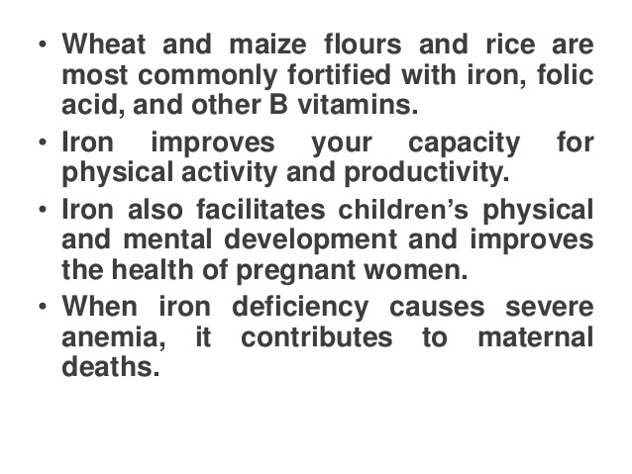

Slide 5
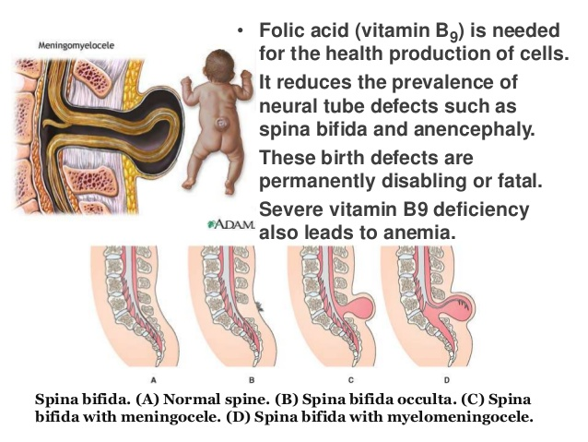

Slide 9
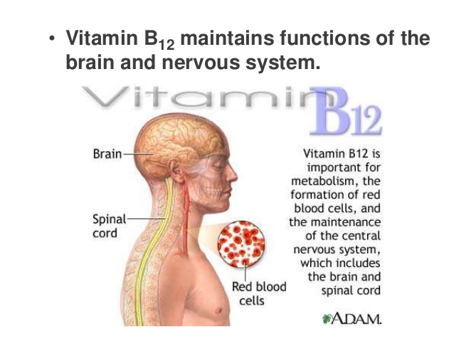

Slide 17
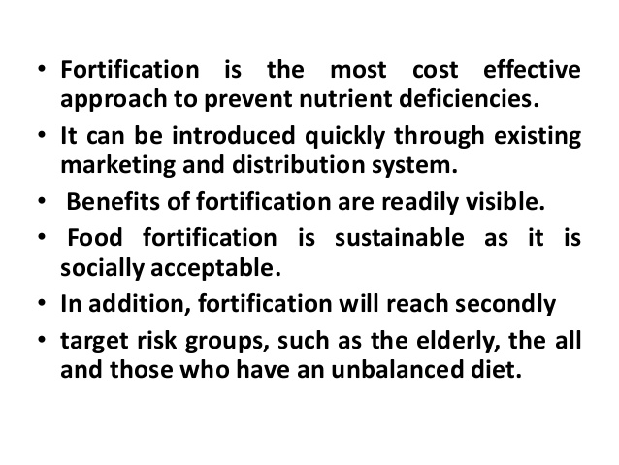

Slide 21
